Slide 1
The Goal Question Metric Approach
Mandana Omidbakhsh

Slide 2
Outline
GQM Definition
GQM Levels
Examples
References

Slide 3
Goal Question Metric Approach
A top-down approach
A measurement framework for evaluation
Overall goals of the project are identified
Some questions are generated with respect to the goals
The questions are analysed to identify measurements
Simple, intuitive approach for specifying metrics
Metrics can be “reused” by several questions

Slide 4
Goal Question Metric levels
A three level Framework:
Goal (conceptual) level
Question (operational) level
Metric (quantitative) level
project
goal1
question1
question2
goal2
question4
metric1
metric2
metric3
metric5
question5
metric4
question3

Slide 5
GQM Goal
A goal has three coordinates and a purpose
Object: could be products, processes or resources
Issue: shows the qualities or properties of the object of measurement
View:specifies the user of output of measurement
Purpose: explains how the output of measurement is used

Slide 6
Example1
Evaluating Student performance in a course

Slide 7
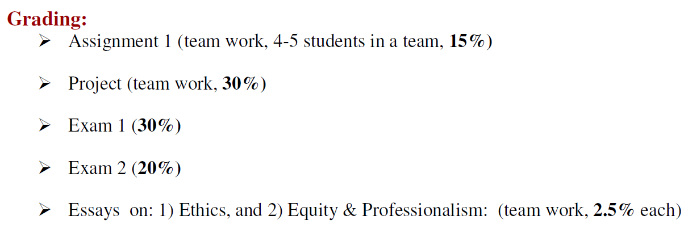

Slide 8
GQM for Example 1
Goal: Student Performance in a course
Question1:
What is the student performance in Assignment of the course?Metric1: Ma
Question2:
What is the student performance in Exam1 of the course? Metric2: Me1
Question3:
What is the student performance in Exam2 of the course? Metric3: Me2
Question4:
What is the student performance in project of the course? Metric4: Mp
Question5:
What is the student performance in essays of the course?
Metric5: Mes1 & Metric6: Mes2

Slide 9
GQM for Example1
Student performance
Question1
Question2
Question3
Me2
Question4
Question5
Ma
Me1
Mp
Mes1
Mes2

Slide 10
Interpretation for Example1
We measure the metrics for each question in scale of 100.
Total= Ma*15%+ Me1*30%+Me2*20%+Mp*30%+(Mes1+Mes2)*5%
Grade | Range
>95 | A+
92.5-95 | A
90-92.4 | A-
88-89 | B+
85-88 | B
80-84 | B-
75-79 | C

Slide 11
Example 2
Improving the usability of a website
A "usable" Web site is designed in such a way that facilitates human interaction
Users could easily find what they need and could complete tasks required fast.

Slide 12
Questions
Goal: Improving the usability of a website
Q1. Does the current website have enough Visibility?
when visiting a web site , users need to know : "Where am I?" and "Where can I go next?“
Q2. Is the current website consistent and does it conform to the standards?
"standards" on the Web means following HTML and other specifications.
Q3. Is there a good matching between the current website and the real world?
The words and phrases used in the website should be familiar to the users' language.
Metrics:
We defined five usability metrics for each question. Each metric is evaluated according to the following scale: High, Medium, Low, No.

Slide 13
Question1
Q1. Does the current website have enough Visibility?
M1: Does every display begin with a title or a header that describes screen contents? Low
M2: Is there visual feedback in menus or dialog boxes about the selectable choices? Low
M3: Does the system provide visibility, in other words, can the user tell the state of the system and the alternatives for action? Low
M4: Do GUI menus make obvious which item has been selected? Low
M5: If users must navigate between multiple screens, does the system use menu maps, and place markers as navigational aids? No

Slide 14
Question2
Q2. Is current website consistent and does it conform to the standards?
M1: Has a heavy use of all uppercase letters on a screen been avoided? No
M2: Are vertical and horizontal scrolling possible in each window? High
M3: Are menu choice lists presented vertically? No

Slide 15
Question3
Q3. Is there a good matching between the current website and the real world?
M1: On data entry screens, are tasks described in terminology familiar to users? Medium
M2: Do the selected colors correspond to common expectations about color codes? High
M3: Are command names specific rather than general? High
M4: Does the command language employ user jargon and avoid computer jargon? High
M5: Do related and interdependent fields appear on the same screen? Medium

Slide 16
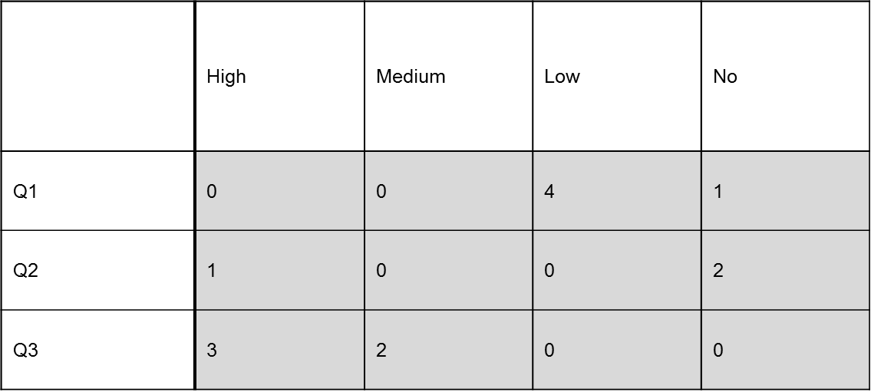
Evaluation
Conclusion: From these evaluations, it is clear that the current website needs to improve its visibility according to result of question#1 and the consistency and the conformance to the standards according to question2.

Slide 17
Example 3
Deciding when software is suitable to be shipped

Slide 18
GQM for Example 3

Slide 19
References
THE GOAL QUESTION METRIC APPROACH, Victor R. Basili, Gianluigi Caldiera, H. Dieter Rombach
“The Goal/Question/Metric Method”, Rini Van Solingen
“A practical view of software measurement and implementation experiences within Motorola” by Michael K. Daskalantonakis. IEEE Transactions on Software Engineering, Vol. 18, Issue: 11, Nov. 1992

